Slide 1













iFeels(Music recommendation using facial expression)
Harshal Patil | 21107060
Arya Patil | 21107009
Faizan Mahimkar | 21107007
Himanshu Maurya | 21107038
Project Guide
Prof. Anagha Aher

Slide 2

1. Introduction
Web application on real-time emotion-based music recommendation, ensuring a more immediate and relevant music experience.
Problem Identified :
The challenge lies in recommending music that aligns with the user's current emotional state.
Users might not engage deeply with music streaming apps due to the lack of personalized and context-aware recommendations.
Solution Proposed :
By delivering emotionally relevant music, the system encourages users to interact more with the app.
Use facial expression recognition to capture the user's emotional state in real-time.

Slide 3

2. Objectives
To Enhance Music Personalization.
To establish a robust mapping between detected facial expressions and a range of emotional states.
To design a comprehensive mapping between recognized emotion and appropriate music genres (Emotion-Music Mapping).
To dynamically generate music recommendations by combining emotional cues with user preferences.
To react to user emotions with respective genre of highly trained model.
To Facilitate User Feedback Mechanism and ensure continuous improvement of the recommendation algorithm.

Slide 4

3. Scope
The system can be used in healthcare settings to assist with stress reduction and relaxation.
The system can add an element of entertainment and interaction to social gatherings, parties, and events.
The system can be applied in educational environments to aid
students' focus and productivity.
The project can serve as a platform for exploring the relationship between emotions and music preferences.

Slide 5
4. Feature /Functionality
Feature 1 : Real-Time Facial Expression Recognition
Analyze expressions like happiness, sadness, joy, anger, surprise, and excitement to understand their emotional states.
Feature 2 : Real-Time Music Recommendations
Based on the detected emotional state and music preferences of user, Provide a dynamic list of songs that match their current emotional context.
Feature 3: User Feedback Loop
Enable users to provide feedback on the relevance of recommended music to their emotions. Incorporate this feedback to refine future recommendations.

Slide 6

5. Outcome of Project
An user-friendly interface for interaction, displaying recommended music and options clearly.
User can give both theoretical & emotional input.
Users are presented with a list of recommended songs that match their detected emotions and preferences by corresponding it to respective genre.
Users can preview recommended music options and select the ones they're interested in.
The system detects and recognizes users' facial expressions in real- time through a camera or uploaded images.

Slide 7

6. Technology Stack
Algorithms Used
FrontEnd
HOG (Divide images into small cells(Histograms))
HAAR (Face detection algo)
SVM (Support Vector Machine)
Facial Landmark Estimation
CNN(Convolutional Neural Networks)
Kmeans Clustering (Method of vector quantification. It partitions n observations into k clusters)
KNN (Supervised ML Algo)
A/B Testing (For user feedback)
HTML/CSS/JS
Bootstrap
Django
BackEnd
OpenCV
Servelit
MySQL

Slide 8
6. Technology Stack
Data Sets :-
Helen dataset – total 2330 images for Face parsing via CRF Neural Network
CKN - 593 video sequence with 123 different subjects from age 18-50
GTZAN – 10 separate genre files with 100 .wav files of 30:00 seconds each
EmoReact – Contains 1102 videos of various expressions.
AffectNet –Manual dataset with 0.4 million images manually labelled according to expressions.

Slide 9
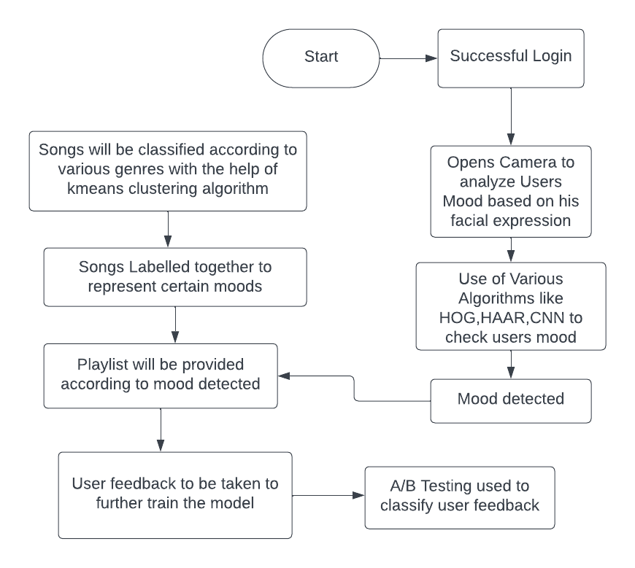

7. Block Diagram

Slide 10
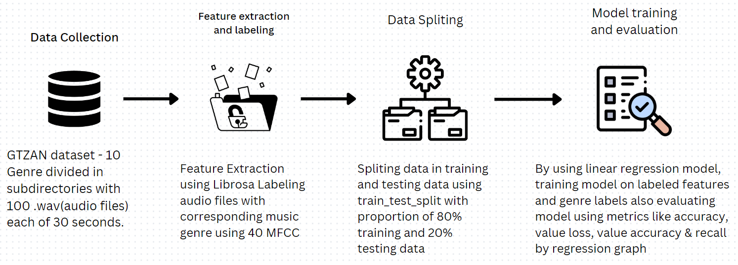
7. Block Diagram

Slide 11
Thank You...!!

